Slide 1
Chem 108: Lab
Sign in: Roster @ front of lab
Pick up replacement page for today’s experiment.

Slide 2
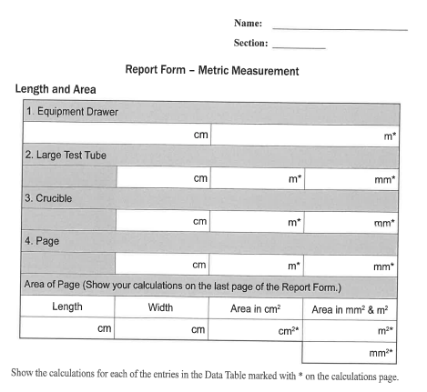
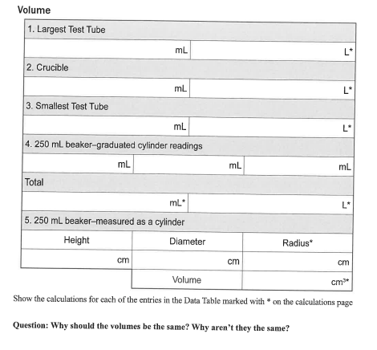
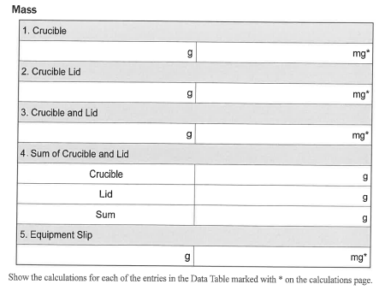
Last Week’s Experiment #1
Metric Measurement
Completed individual forms pp. 12-15
due today by the end of lab.
Include calculations. Staple together with partner’s form
and turn in before the end of lab.
Most legible report pages on top.

Slide 3
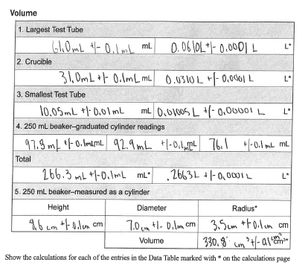
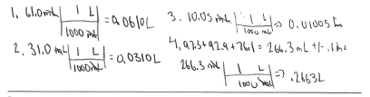
Metric Measurement: Experiment #1
Example of an acceptable set of student data, conversions, and calculations.
DO NOT COPY.
Use as a guide.

Slide 4
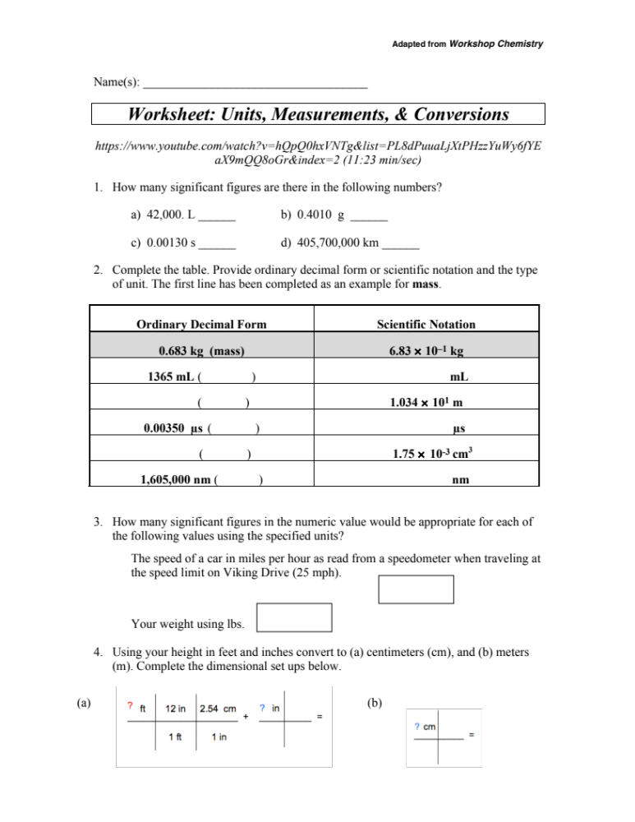
Worksheet (Handout): Due 20-Feb. Collaboration is encouraged.
Turn in one with the names of all contributors.
http://chemconnections.org/general/chem108/Math%20%26%20Measurements-WKS.f18.pdf

Slide 5
Experiment #2:
Measuring Density
CHEM 108

Slide 6
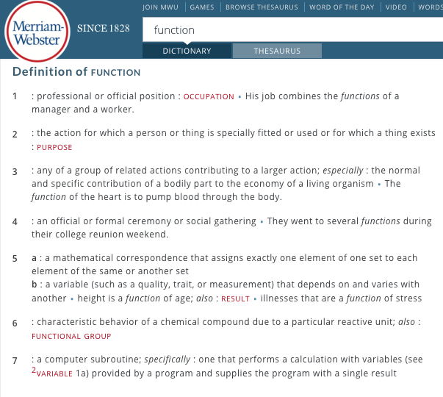
Comparison of Relative Properties
FUNCTIONS
Density is a function of an object’s mass and volume.

Slide 7
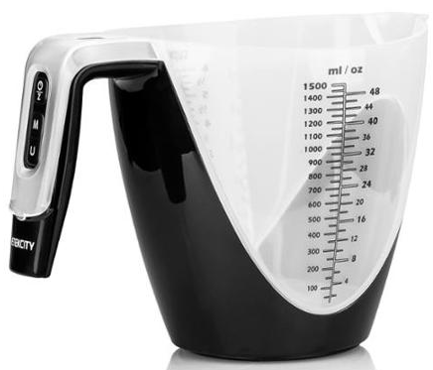
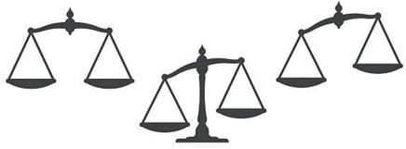
Comparisons of Relative Properties
FUNCTIONS
density : mass : volume
Functions & variables can be described interchangeably between:
Density
Images (Symbols)
Words
Sounds (Voice)
Numbers
Tables
Graphs
Formulas
Powers of Ten (Images) http://www.wordwizz.com/imagendx.htm
http://www.eamesoffice.com/
Mass Volume
Density is a function of an object’s mass and volume.

Slide 8
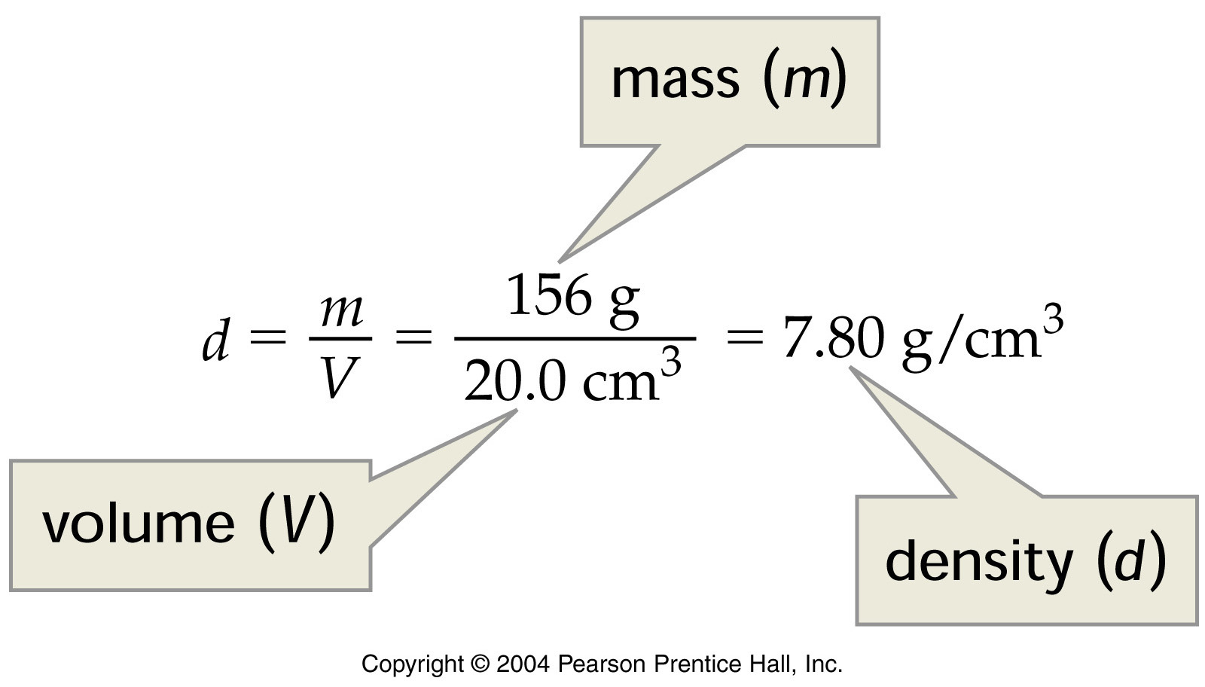
Density
http://www.density.com/what.htm
Density = Mass / Volume [g/mL or g/cm³; g/L]
Notes:
Calculation of iron density
Notes:
Proper units for density are mass per unit volume.

Slide 9
Experiment #2
Measuring Density
  Do Today
Goal: To measure diameter and height of a metal cylinder and calculate the respective volume.
  To plot mass versus volume and determine slope of “trendline(s)”.
  Using 2 different methods, to measure mass and volume of a liquid, and to determine which method results in higher–precision (most decimal places)
  To measure mass and volume of a solid using instruments of different precision, and determine which method results in highest–precision
Work with same lab partner(s) as the Metric Measurement Experiment
  Be sure to write yours and partners’ names ON both REPORT FORMS DUE Week #5

Slide 10
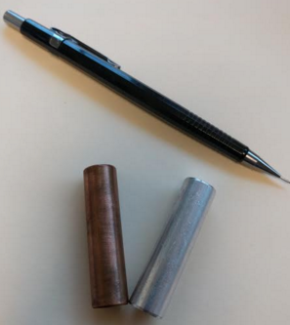
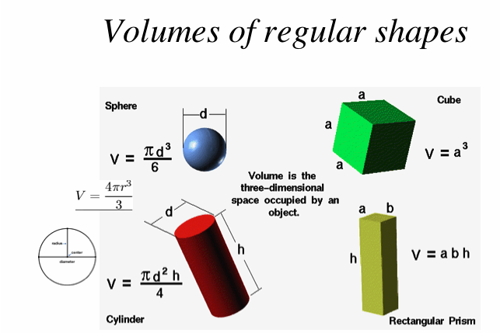
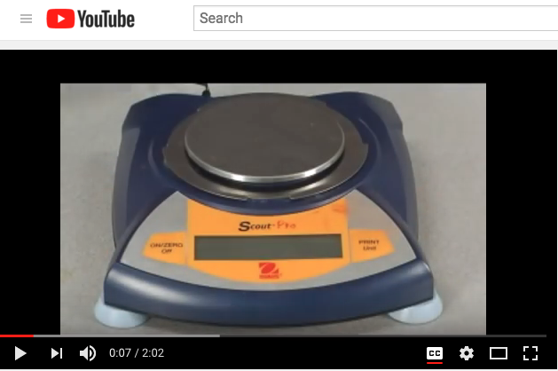
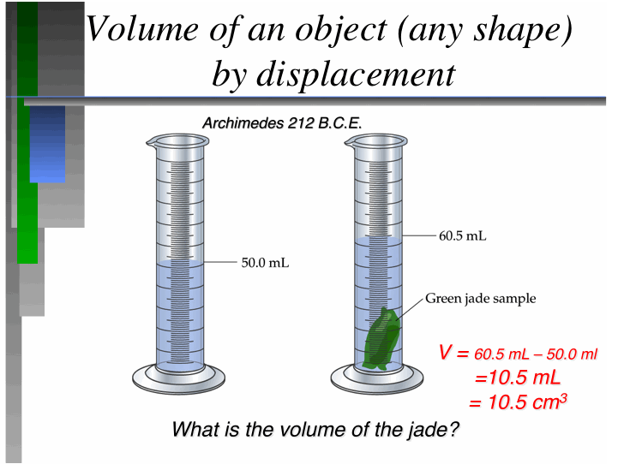
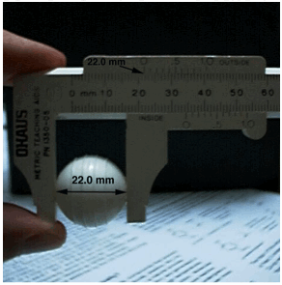
  Do Today
Chem 108 Lab: Experiment #2
[Method 2]

Slide 11
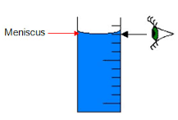
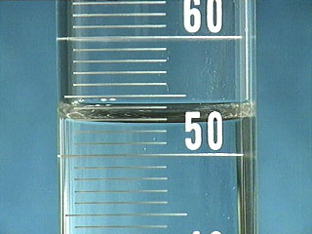
Reminder:
Measuring with a 100 mL Graduated Cylinder:
52.9 mL
meniscus
Measure
bottom of the meniscus at eye level

Slide 12
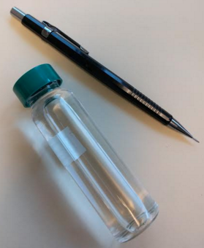
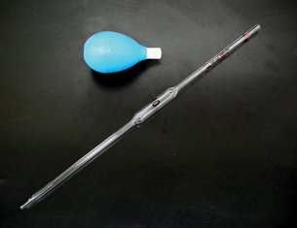
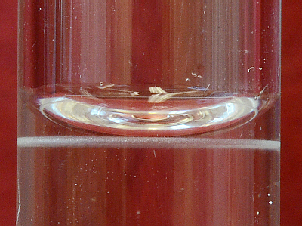
Measurement using a volumetric pipet:
meniscus
Bottom of the meniscus MUST be at calibration line for accurate measurement

Slide 13
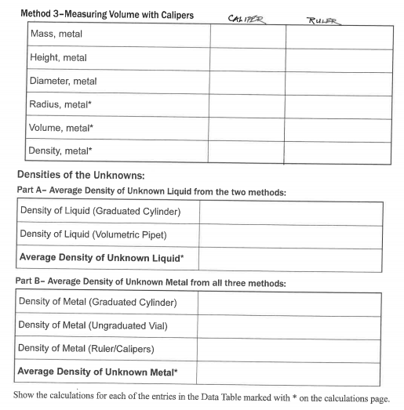
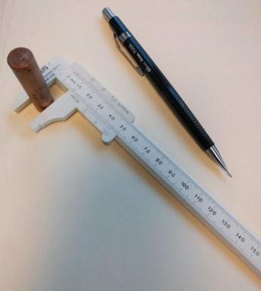
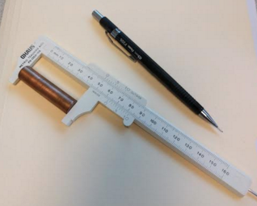
Add a column to pg. 22 & label both of them
Each partner to measure with both Caliper and Ruler & compare

Slide 14
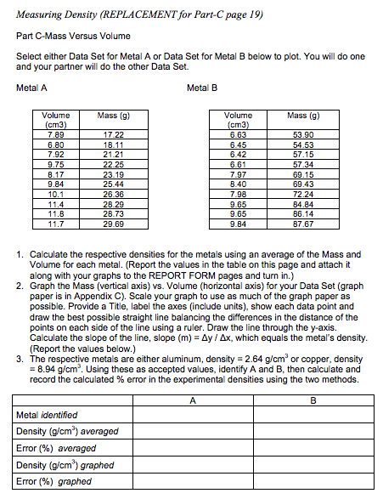
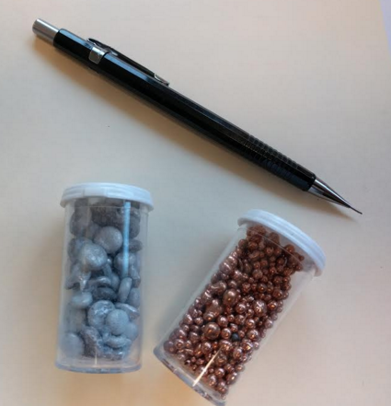
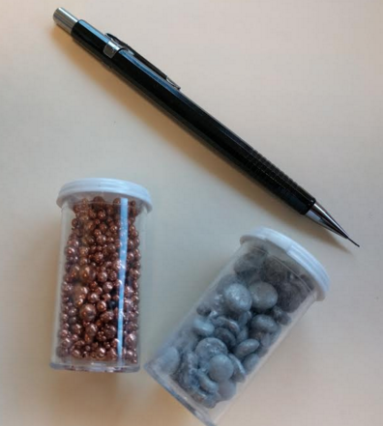
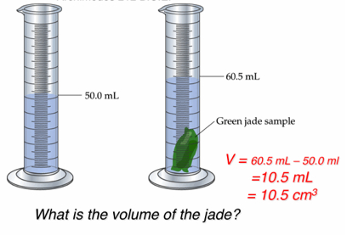
Replace Part C, pg. 19 with handout
http://chemconnections.org/general/chem108/Measuring%20Density-graphing.2017.pdf
Method 2:

Slide 15
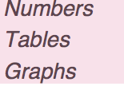
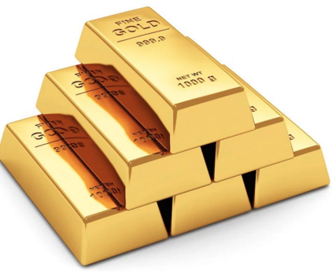
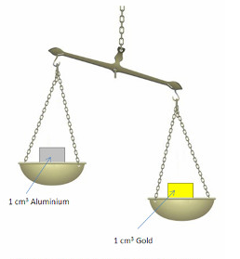
Density
Mass & Volume
Unknown Metal
Sample | Mass (grams) | Volume (mL)
1 | 10.0 | 0.5
2 | 55.0 | 2.8
3 | 113.5 | 5.9
4 | 586.0 | 30.4
5 | 1587.0 | 82.2
6 | 2270.0 | 117.6
Numbers, Tables, & Graphs
Notes:
Table

Slide 16
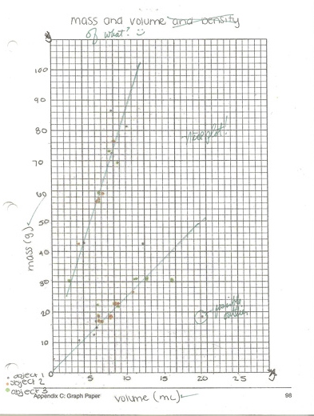
Plot data using blank graph paper in back of Lab Manual pp. 119 – 121
Data & instructions are provided on handout
http:// chemconnections.org/general/chem108/Measuring Density-graphing.2017.pdf
Plot all data for either Metal A (one partner) or Metal B (other partner): Can be on the same graph paper or separate. If on the same paper be sure to consult with partner on the scales to use.
Complete the bottom table of handout and attach to the Report Form to turn in.

Slide 17
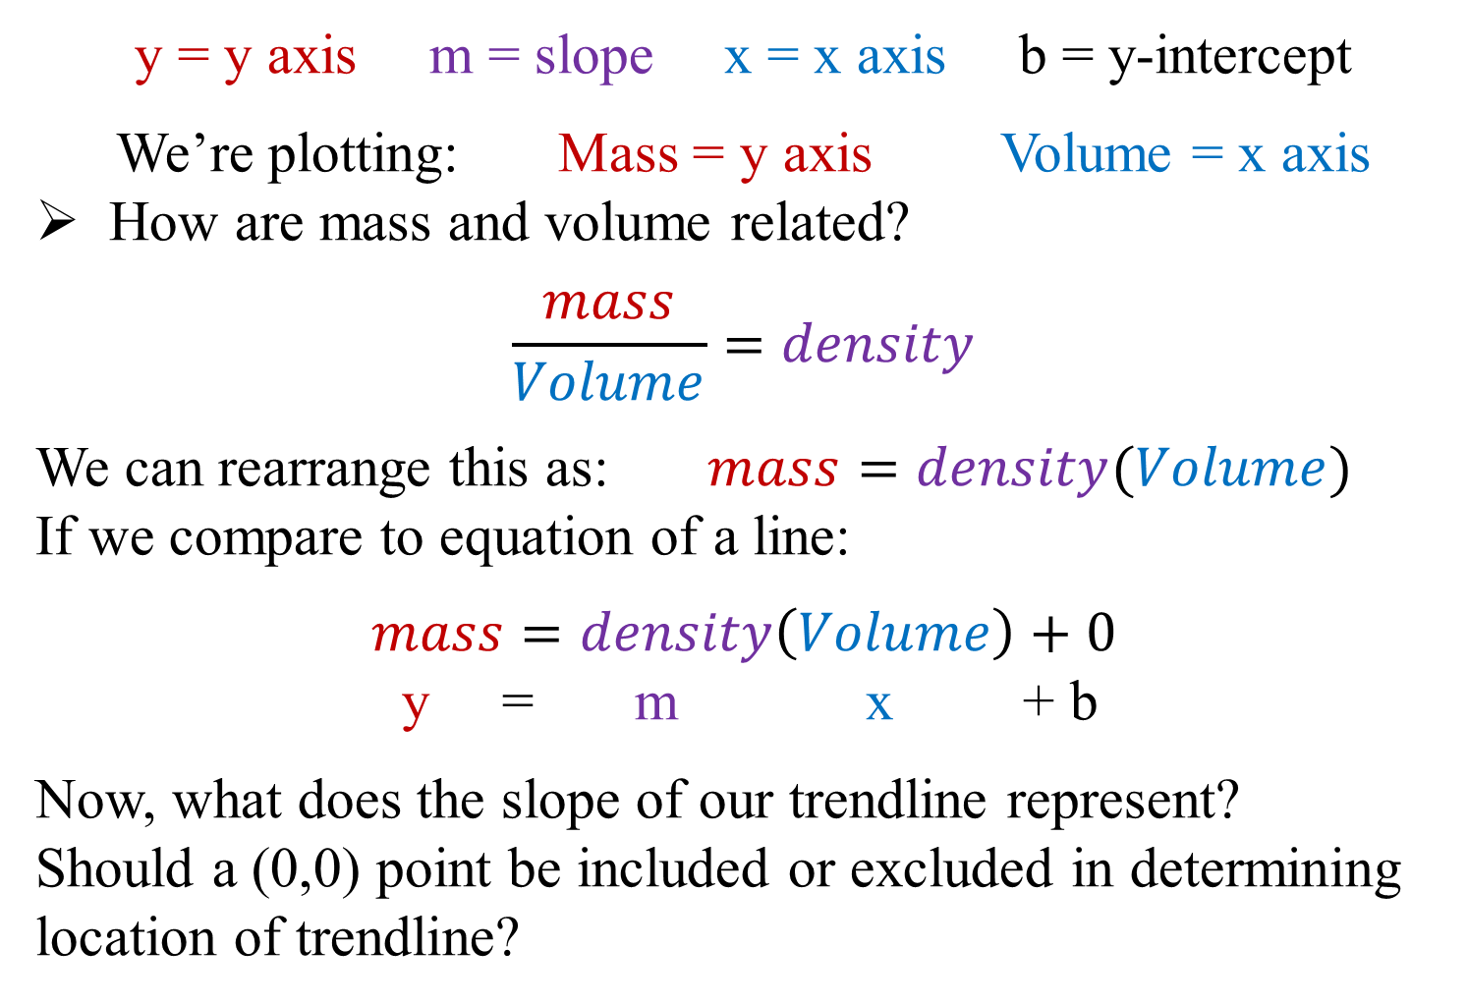
Equation of a line: Δy = mΔx + b
Δ
Δ
Δ
Δ

Slide 18
Plotting data
A good plot should have:
  An appropriate scale
  Labeled axes (with units)
  An appropriate title
Use a ruler to estimate best-fit line for data that appears to group together (It is NOT connect-the-dots)

Slide 19

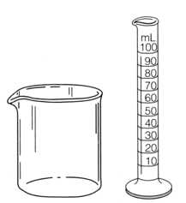

Different Volumetric Tools
+/- 5 mL
+/- 0.1 mL
+/- 0.01 mL
Both =
+/- 0.01 mL
A B C D
True (A) / False (B)
A and D have the same level of precision.
The following is the correct order of increasing precision: D < C < B.

Slide 20
Complete both columns pg. 22
Each partner to measure with both Caliper and Ruler & compare

Slide 21
Using a Caliper
Come up with partner having names on both lab forms.
You & partner will be provided unknown liquid & unknown metals, caliper & ruler.

Slide 22
Measuring the cylinder

Slide 23
Read instructions carefully & discuss with partner before beginning.
Return empty liquid vials & metal cylinders when finished.
Liquid is salt solution that can be poured down drain.

Slide 24
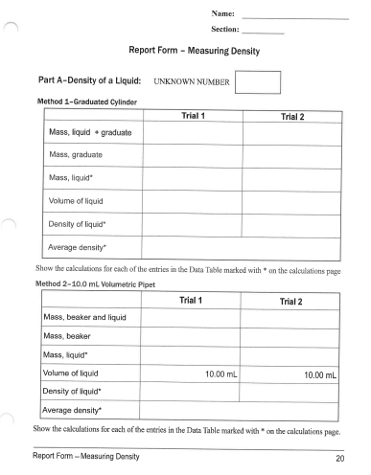
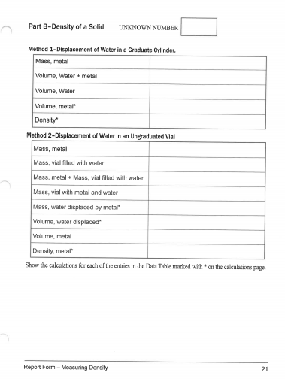
Experiment #2 –Measuring Density
Complete and record all measurements pp. 20-22 today. Omit pg. 23 and Trial 2 pg.20
Have individual forms initialed before leaving lab today.
Only your measurement data is due to be signed today.
Be certain of calculations, graphs & questions before leaving lab.

Slide 25
Next Week: (Week #4)
Check Calendar; Monday is a holiday; Wednesday: Open Lab & Help Session
Complete density calculations, graphs & Report Form pp.20-22, & pp. 24-25; attach completed replacement pg. 19 plus graphs (One complete set for each lab partner to be turned in; stapled together clearest report first.)
DUE Week #5
(GQ) On-line Density & Buoyancy Guiding Questions (individually done)
https://phet.colorado.edu/sims/density-and-buoyancy/density_en.html
DUE Week #5

Slide 26
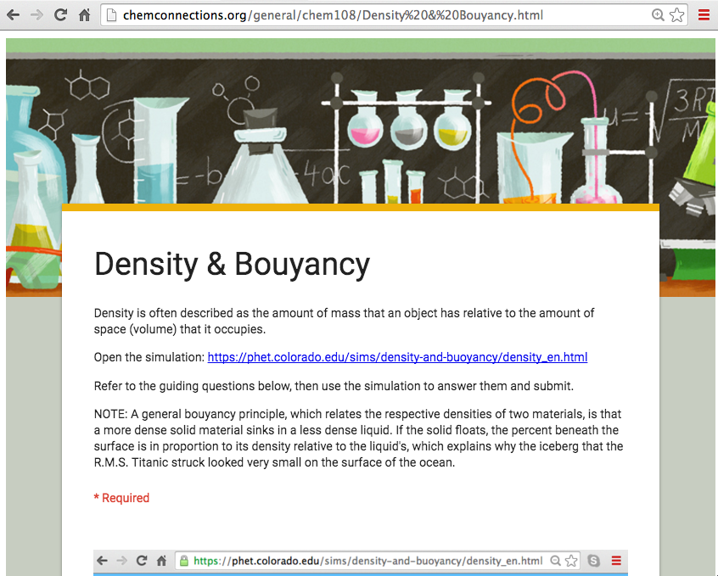
(GQ) On-line Density & Buoyancy Guiding
DUE Week #5
http://chemconnections.org/general/chem108/Density%20&%20Bouyancy.html

Slide 27
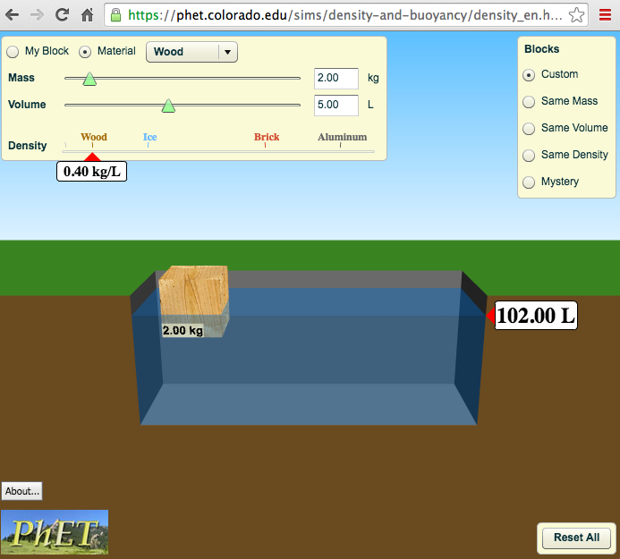
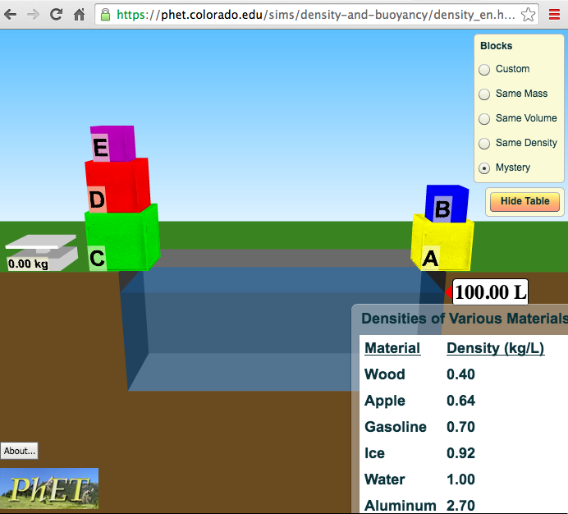
(GQ) On-line Density & Buoyancy Guiding Questions
DUE Week #5
https://phet.colorado.edu/sims/density-and-buoyancy/density_en.html

